Slide 1
Non Verbal Communication

Slide 2
Nonverbal Communication
Is it possible to communicate without words?

Slide 3
Nonverbal Communication
Studies show that over half of your message is carried through nonverbal elements:
Your appearance
Your body language
The tone and
the pace of your voice.

Slide 4
Nonverbal Communication
Before someone processes our verbal messages,
Taken in our appearance,
Registered our enthusiasm and sincerety
Noted our tone of voice and processed all into nonverbal message.
If this message reinforce the content of verbal one, it means we send a powerful message.
If the two messages do not match, they may cancel each other and that means nomessages delivered.

Slide 5
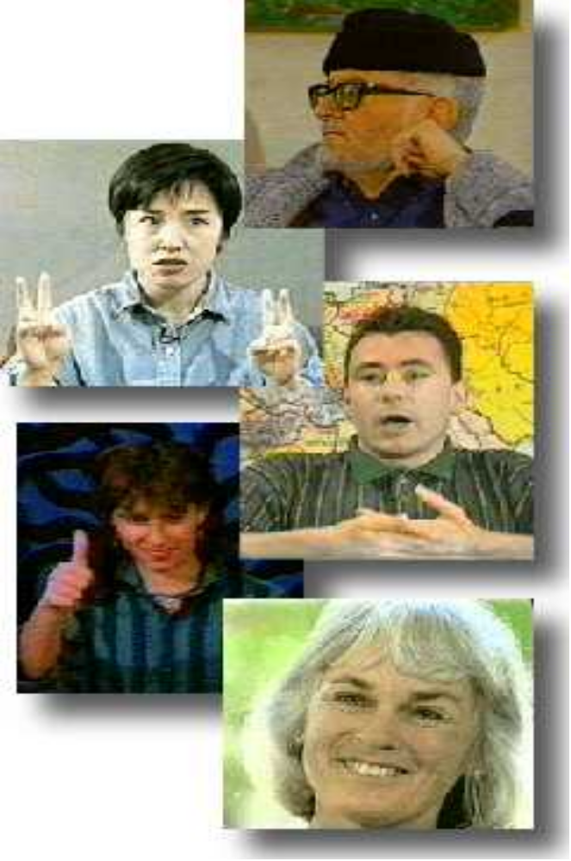
Nonverbal Communication
The process of sending and receiving wordless messages by means of facial expressions, gaze, gestures, postures, and tones of voice.
Nonverbal cues include all expressive signs, signals and cues ---which are used to send and receive messages

Slide 6
Language is not the only source of communication, there are other means also. Messages can be communicated through.
1. Gestures: It includes movement of hands, face or other parts of the body.
2. Posture or Body language
3. Facial expressions
4. Eye contact
5. Emblems
6. Haptics
7. Appearance & object

Slide 7
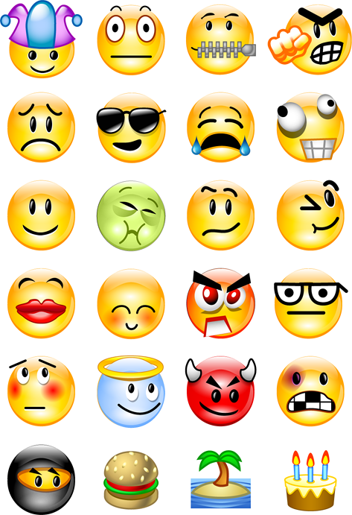

Slide 8
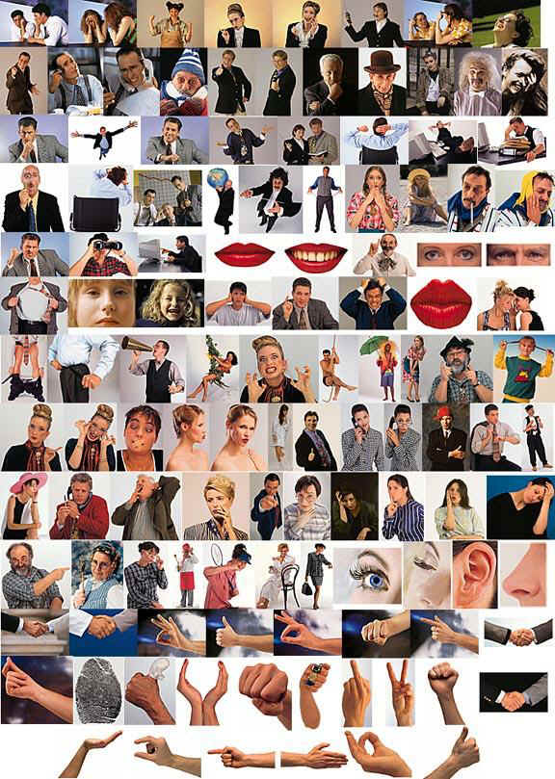

Slide 9
Meaning can also be communicated through object
  Clothing
  Hairstyle
  Architecture
  Symbols
  Dance
  Icons (Image, picture, or representation)
  Handwriting style
  arrangement of words
  physical layout of a page

Slide 10
Vocalizations
Non verbal sounds - not words, but convey a meaning.
Divided into three categories:
  vocal characterizers
  vocal qualifiers
  vocal segregates

Slide 11
vocal characterizers
Laughing
Sighing
Crying
Belching
Inhaling
Excessive groaning
Whining
Yelling
Whispering

Slide 12
vocal qualifiers
intensity (loud-soft)
pitch height
high-low

Slide 13
vocal segregates
(separators)
“um” “uh” “ah”

Slide 14
Note:
some sounds are not vocal,
e.g., snapping one’s fingers, stamping a foot
…nv includes vocal and non vocal phenomena

Slide 15
Some nonvocal
made with the breath,
taking a small bit of air
onomatopoetic words - zzz

Slide 16
Also other vocal phenomena
more sounds than words e.g., zap...buzz

Slide 17
Body Motion
(Kinetic Gestures)
Movements of the:
  Body
  Limbs
  Head
  feet and legs
  facial expressions
  eye behavior
  posture

Slide 18
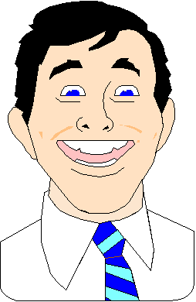
Some movements provide information about emotions
Some give information about personality traits or attitude

Slide 19
Emblems
Thumbs up OK
V with fingers victory
Finger pointed to temple suicide
Hand grasping throat choke
hand to mouth eating
tilt head, eyes closed sleeping

Slide 20
Use of Emblems (a)
Insults
Directions
come go
stop slow down
Greetings
Departures

Slide 21
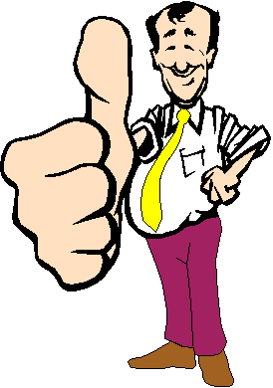

Slide 22
Use of Emblems (b)
selected responses to questions
yes no
maybe I don’t know
physical state
emotion
triumphant angry
sad

Slide 23
Part of body associated with emblems
Often the hands... but not exclusively
Nose wrinkle Disgust
Drop of the jaw and exaggerated
raising of the eyebrows Surprise
Upturned palms, shrugged shoulders Uncertainty

Slide 24
Regulators 2
They can tell the speaker to:
continue
hurry up
become more interesting
explain
let the other talk

Slide 25
Turn-taking regulators
(the most studied kind)
Head tilting
Nods
Eye contact
e.g. less eye contact if you want to terminate conversation.

Slide 26
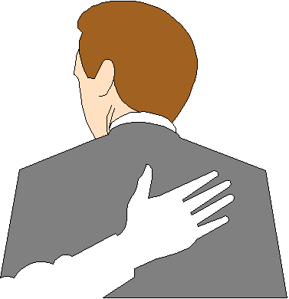
Touch
Behavior
touching
stroking
pushing
guiding another’s motion

Slide 27
Paralanguage
How - not what you say.
Speech behavior
  Voice quality and pitch
  Range and rhythm control
  Tempo
  Articulation
  Resonance
  Glottis control
  Vocal and lip control

Slide 28
We Express Ourselves Through….
Posture( Gait, Walk, sitting)
(Position of body)
Gestures( Movements of hands , Legs, fingers etc.)
(A Motion of hand, head or body to emphazize an idea or emotion while speaking)
Facial Expressions(Eyes, eyebrows, lips,chin)

Slide 29
Sensory Channels
It is also important to remember that while communicating we not only use different frames of mind but also use various sensory channels like ;
Verbal contents ( Words)
Auditory content ( Voice tone)
Visual content ( gestures, facial expressions) and sometimes sense of touch and smell ,too.

Slide 30
The Silent Language :
The Non Verbal Communication
Our actions
silence
expressions in the eyes
gestures
posture
walk
Facial expression
Vocal cues
Touch
Appearance
-all these can communicate without words.

Slide 31
Emotions- Express with Facial
Expressions
Surprise
Fear
Disgust
Anger
Happiness
Sadness

Slide 32
Four basic modes of Body Language.-
Responsive- ( Eager)
Reflective-(Evaluating)
Fugitive -(Bored)
Combative- ( Aggressive)

Slide 33
Two basic groups of postures:
OPEN/CLOSED and FORWARD/BACK
OPEN/CLOSED is the most obvious. People with arms folded and legs crossed and bodies turned away are signaling that they are rejecting messages.
People showing open hands, fully facing you and both feet planted on the ground are accepting them.

Slide 34
FORWARD/BACK
FORWARD/BACK indicates whether people are actively or passively reacting to communication. When they are leaning forward and pointing towards you they are actively accepting or rejecting the message.
When they are leaning back, looking up at the ceiling, doodling on a pad, cleaning their glasses they are either passively absorbing or ignoring it.

Slide 35
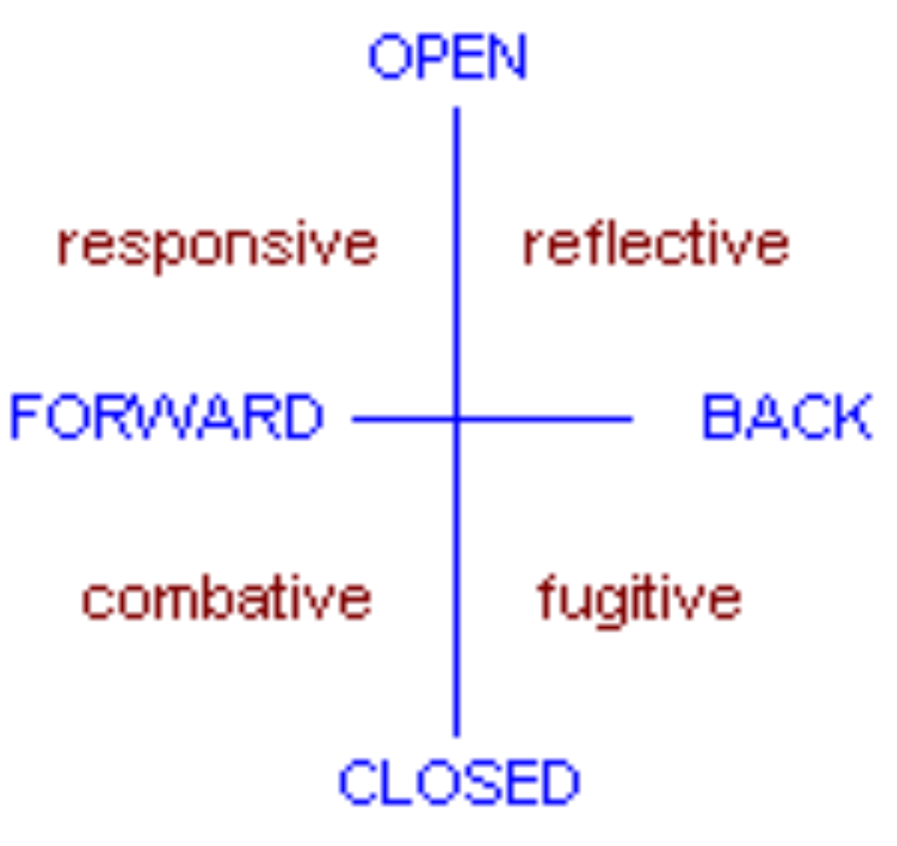
( Eager)
(Evaluating)
( Aggressive)
(Bored)

Slide 36
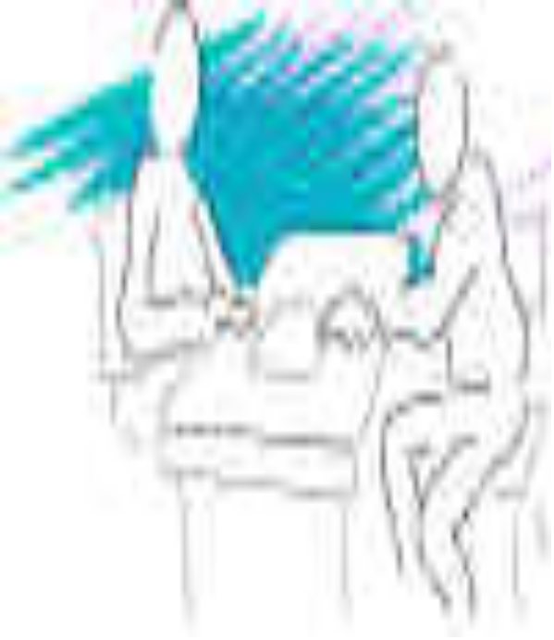
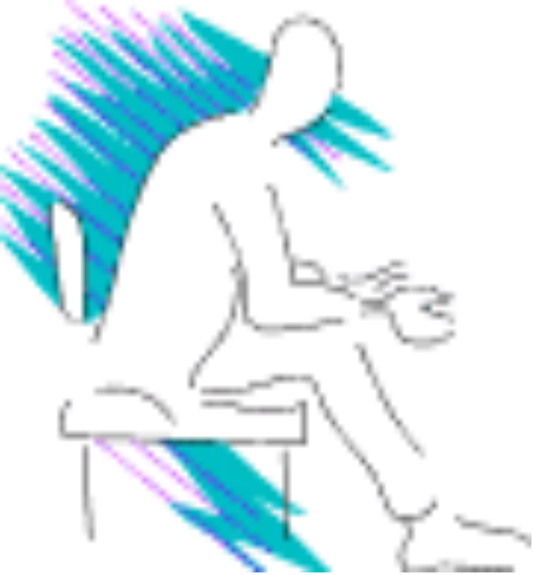
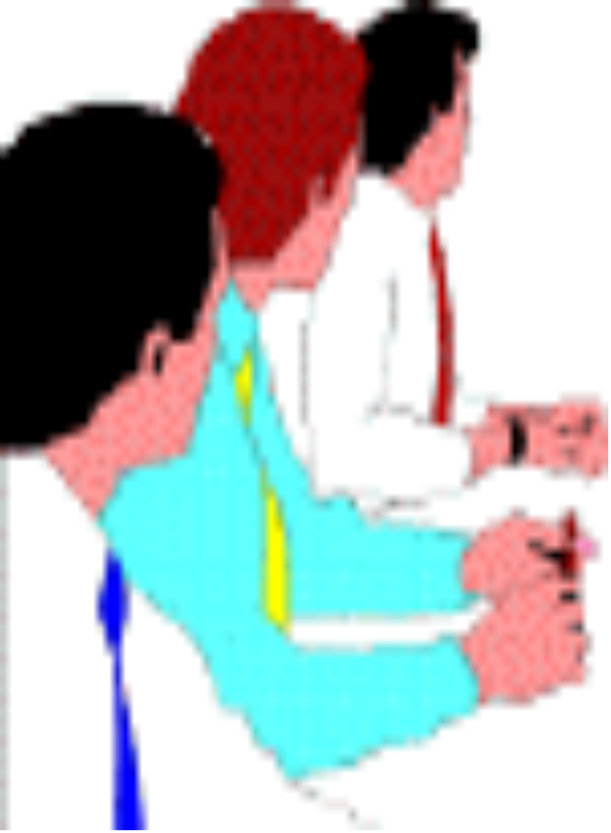

Responsive
ENGAGED
Leaning forward
Open body
Open arms
Open hands

Slide 37
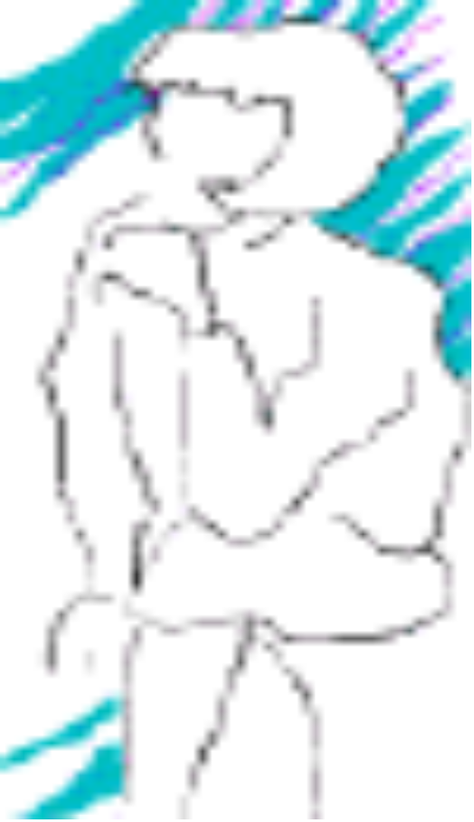
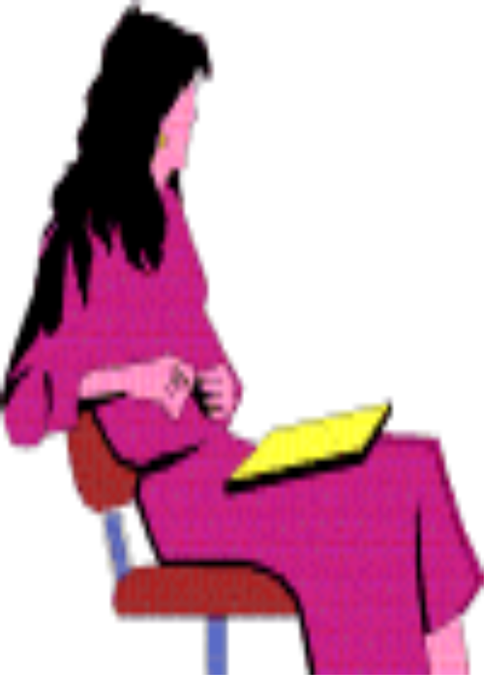
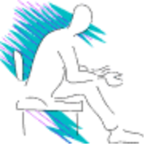





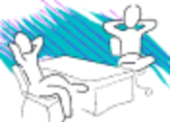
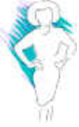
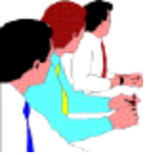

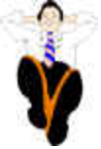
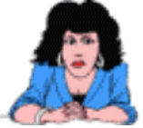


Reflective
LISTENING
Head tilted
Lots of eye contact
High blink rate

Slide 38

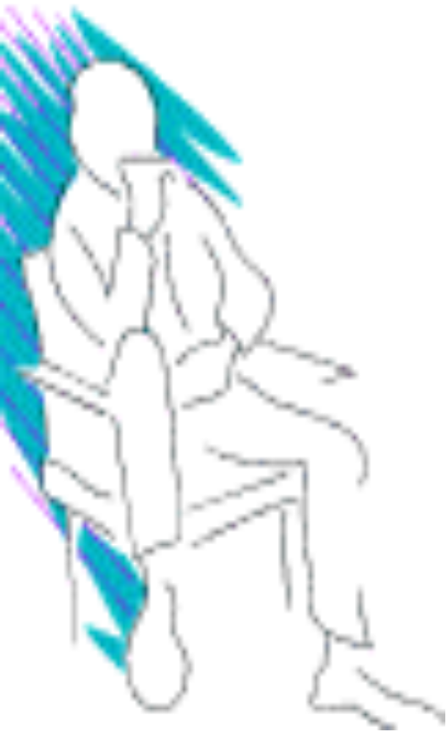
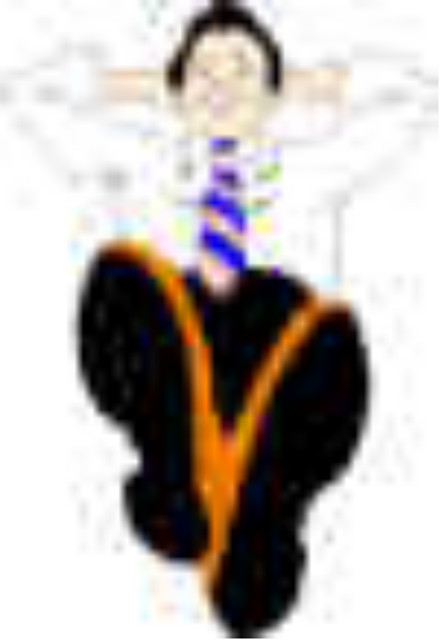

Fugitive
BORED
Staring into space
Slumped posture
Doodling
Foot tapping

Slide 39

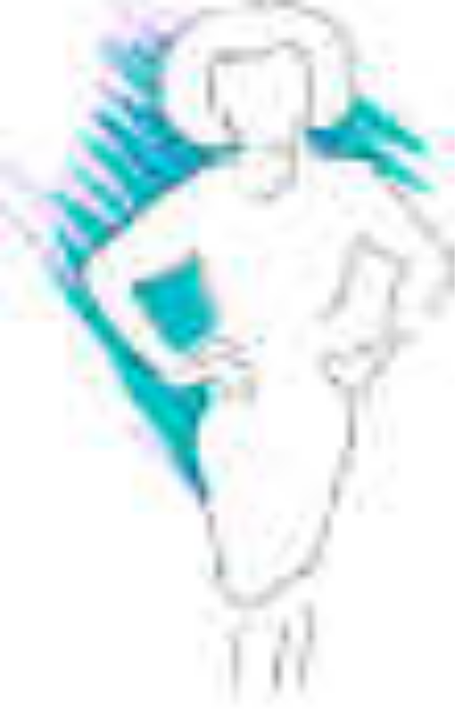

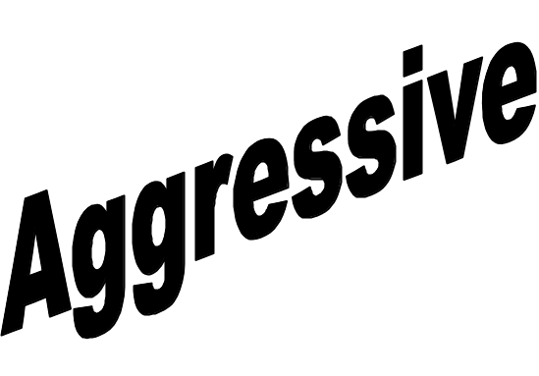
Combative
LET ME SPEAK
Finger tapping
Foot tapping
Staring

Slide 40
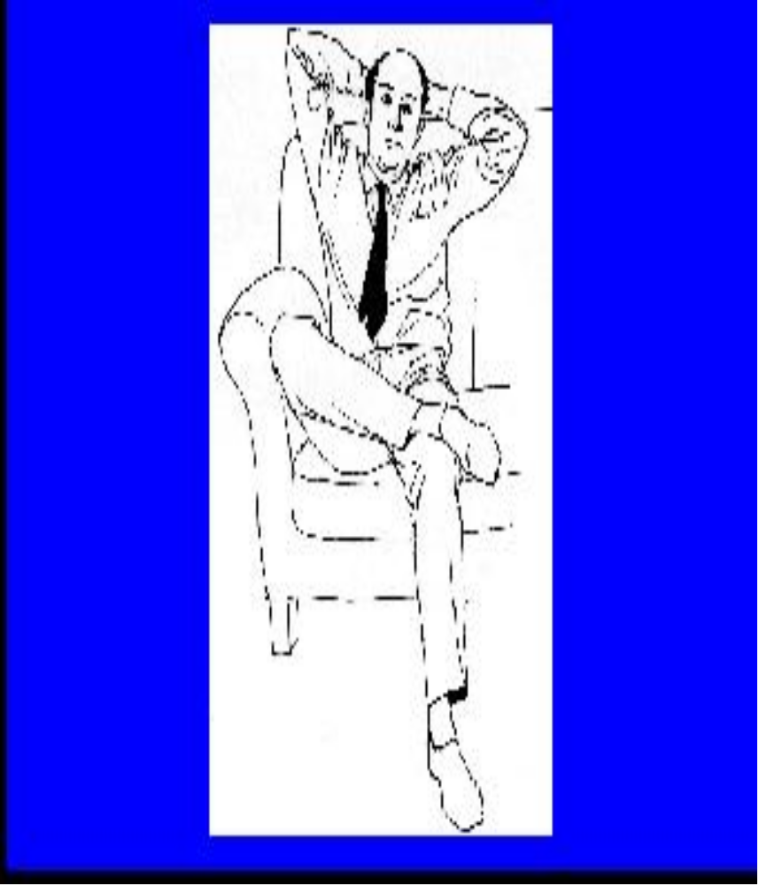
Leaning Back With hands Supporting Head
Superiority
Relaxed
Rejecting Messages

Slide 41
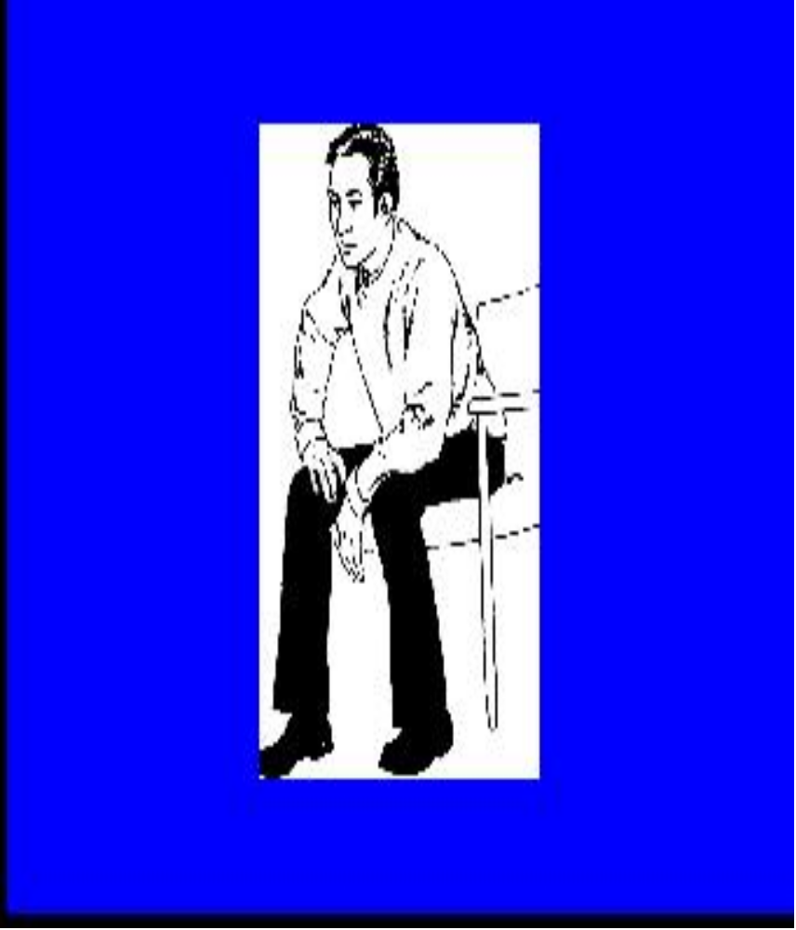
Ready
Positive
Able
Goal oriented person
Sit down readiness

Slide 42
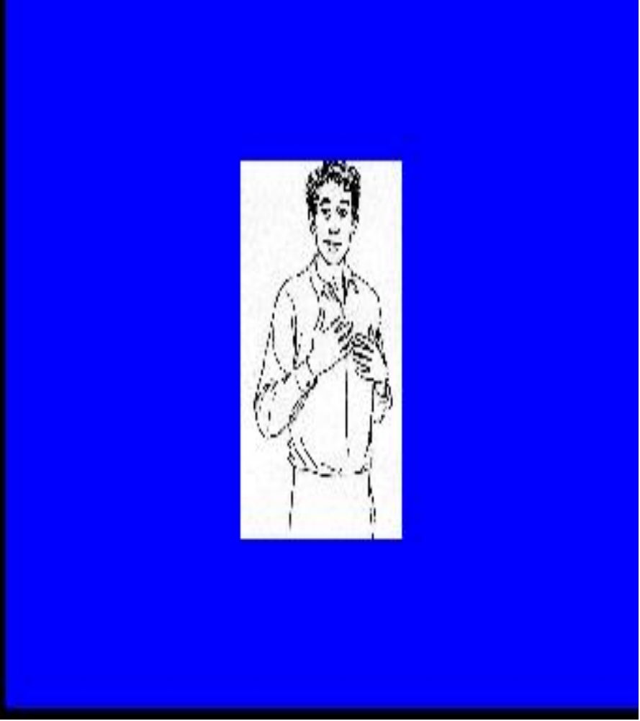
Honesty
Loyalty
Devotion
Hand to Chest

Slide 43
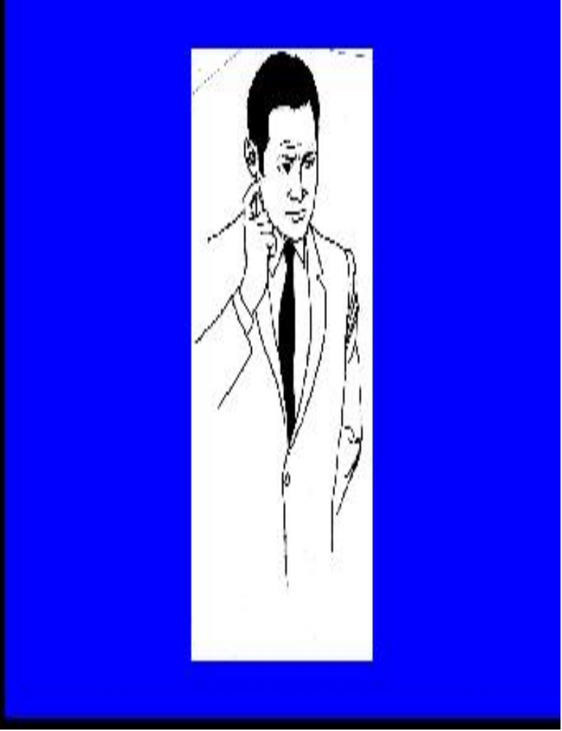
A Doubt
Hesitance
“Well, I don’t Know ”

Slide 44
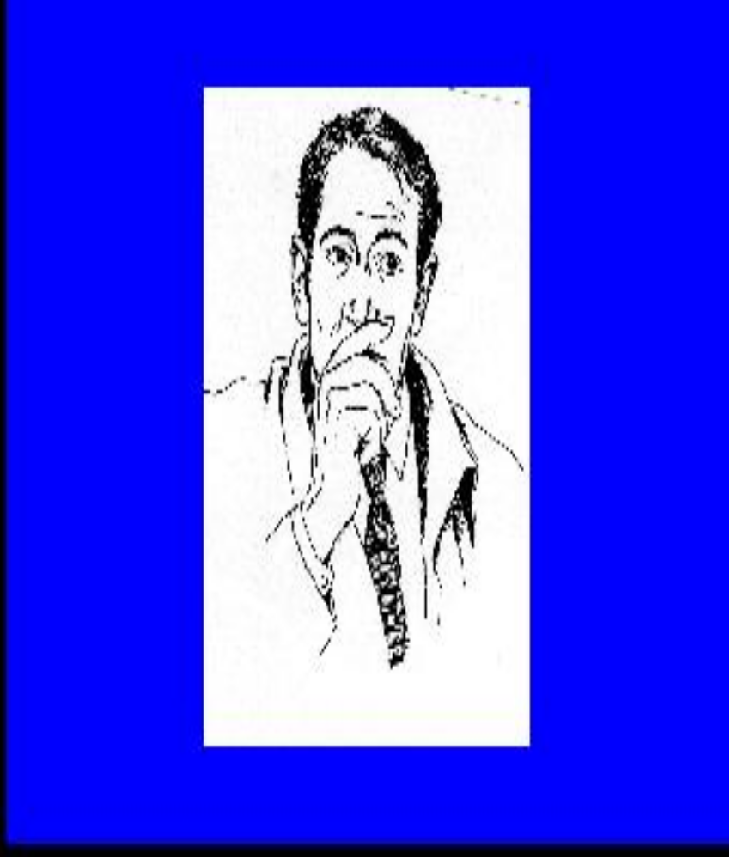
Curiosity
Touching the Nose

Slide 45
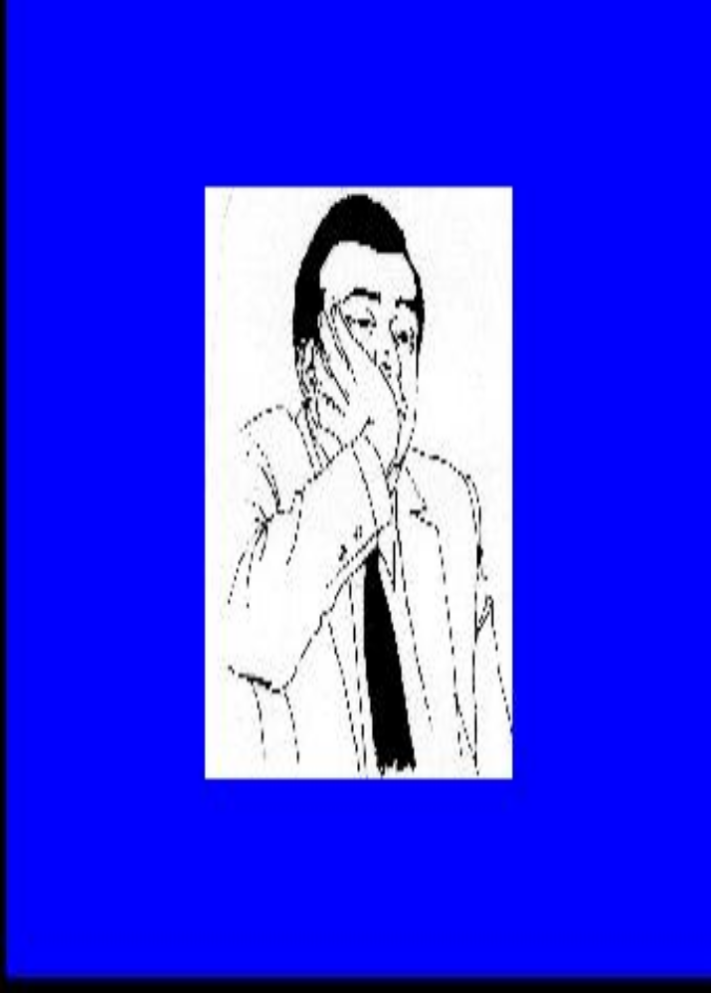
Boredom
Tired
“ I am bored.”

Slide 46
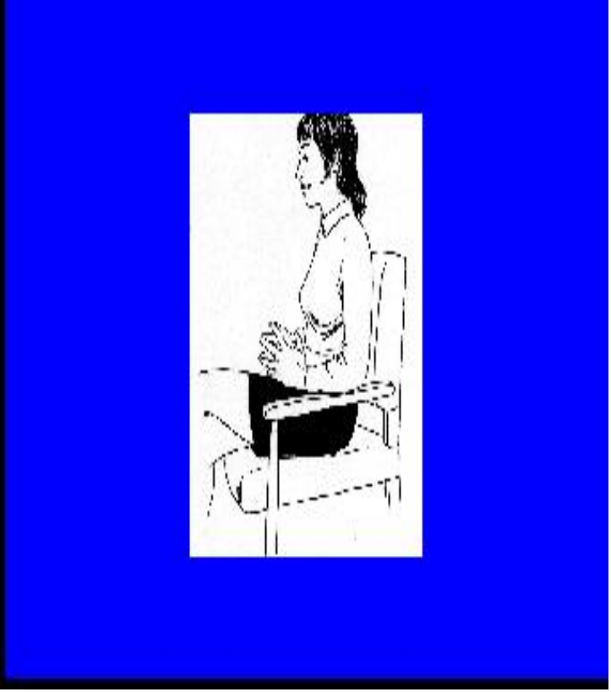
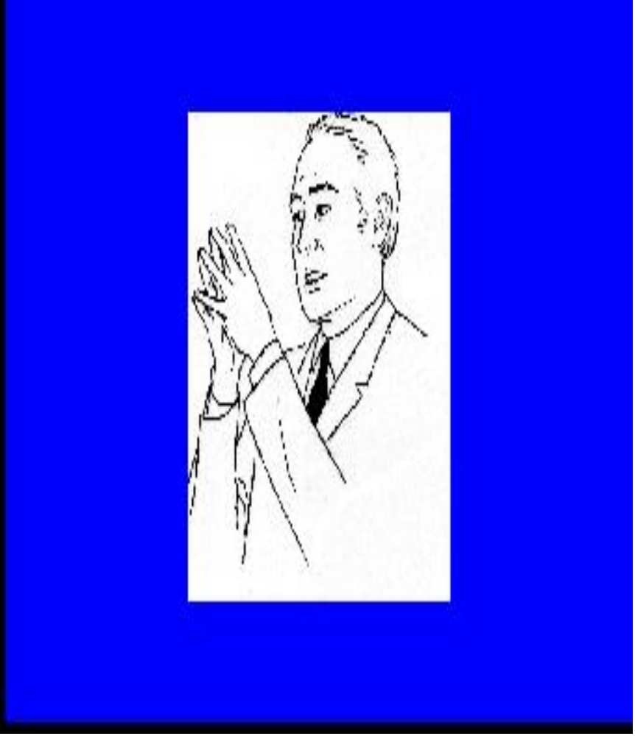
Confident
Proud
Egotistic
Low Steepling ( Joining Finger tips)
Sleeping

Slide 47
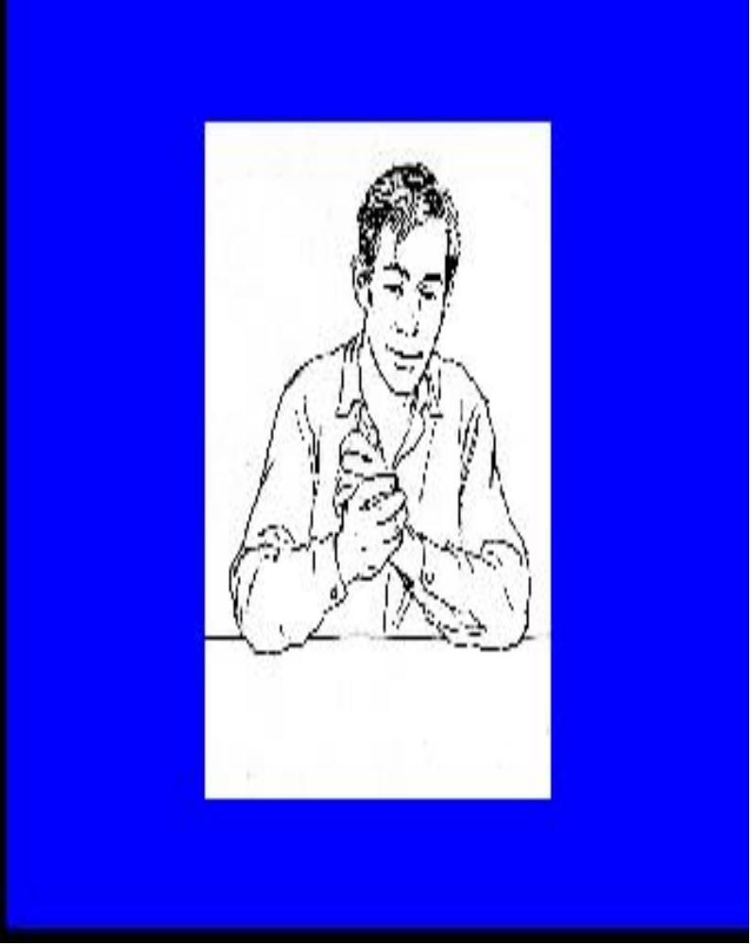
Expectation
Unspoken demand
Hand Rubbing

Slide 48
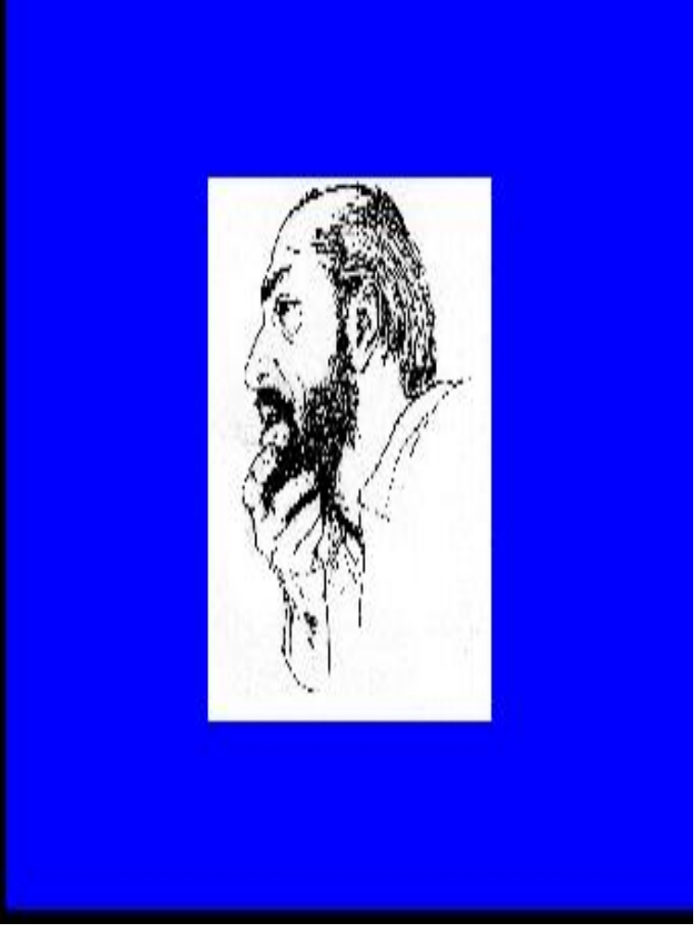
Evaluating
Judging
Chin -stroking evaluation

Slide 49
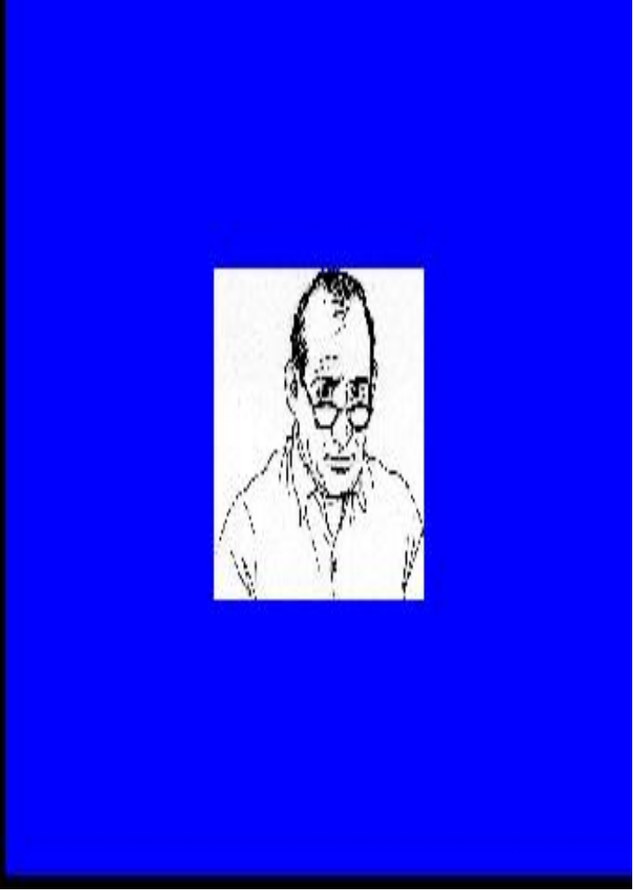
Negative Emotional Reaction
Scrutinizing people
Gesture with glasses

Slide 50
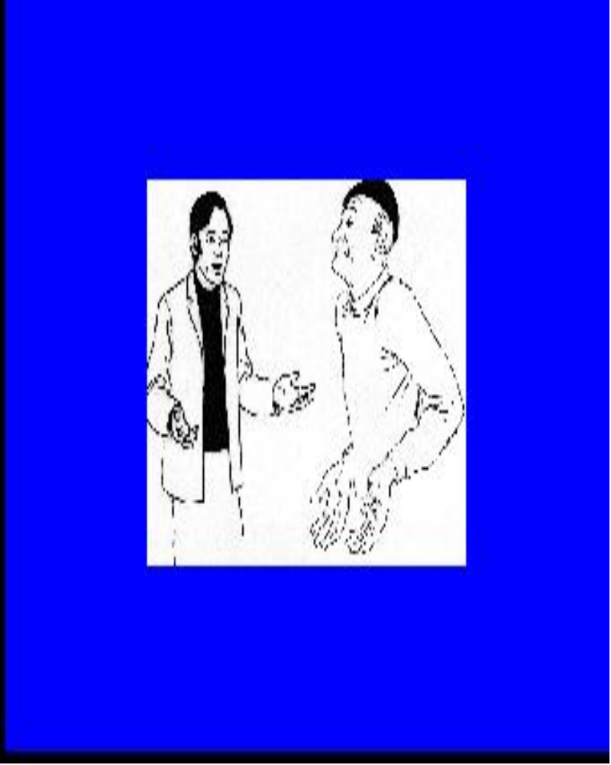
Open Hands
Sincere
Open to suggestion
Acceptance of
authority
Frustration
Helplessness
Sincerity
Helplessness

Slide 51
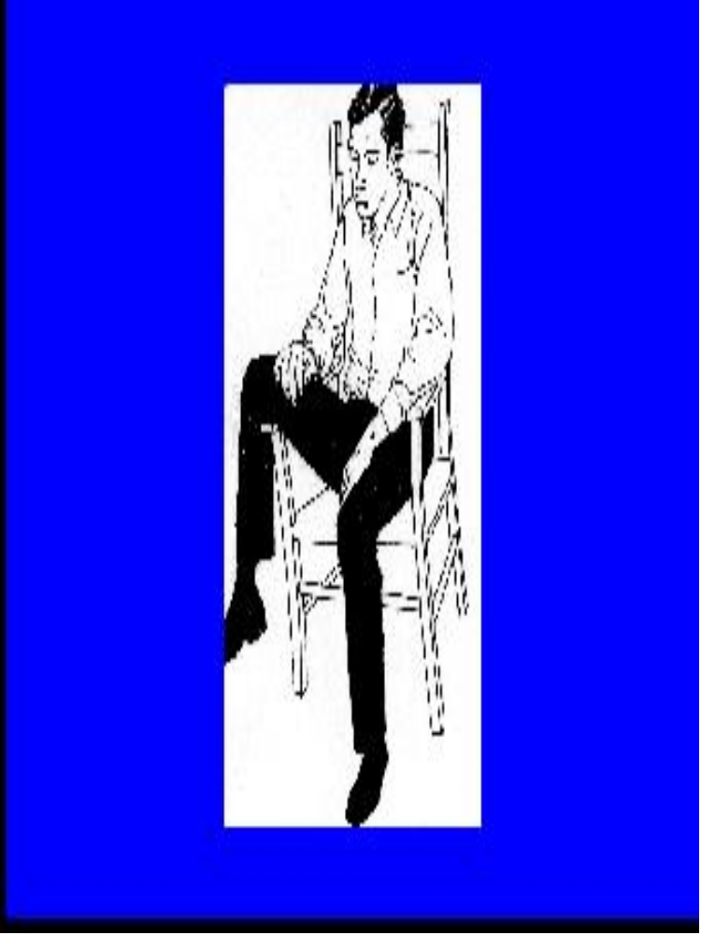
Non- Cooperative
Hostile
Unconcerned
Getting a Leg up

Slide 52
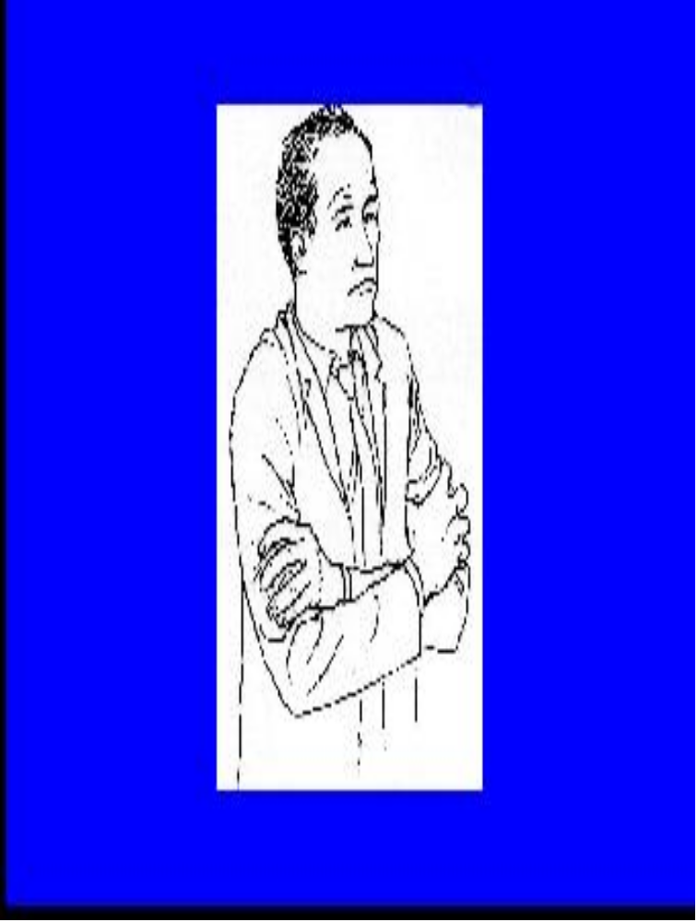
Defensive
or
Sometimes,
seeking comfort
Arm Gripping

Slide 53
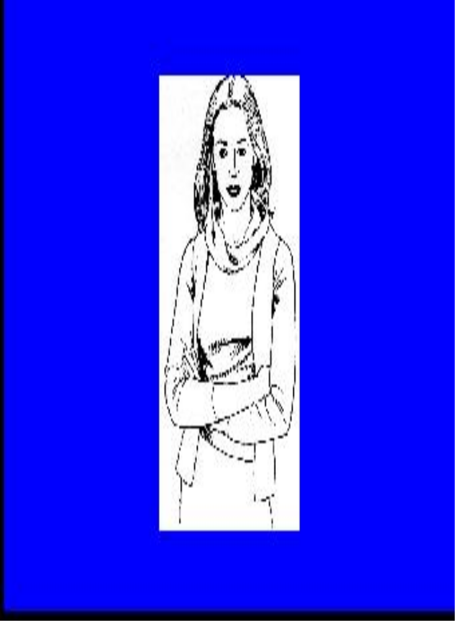
Preferred by teenage girls
Crossed Arm

Slide 54
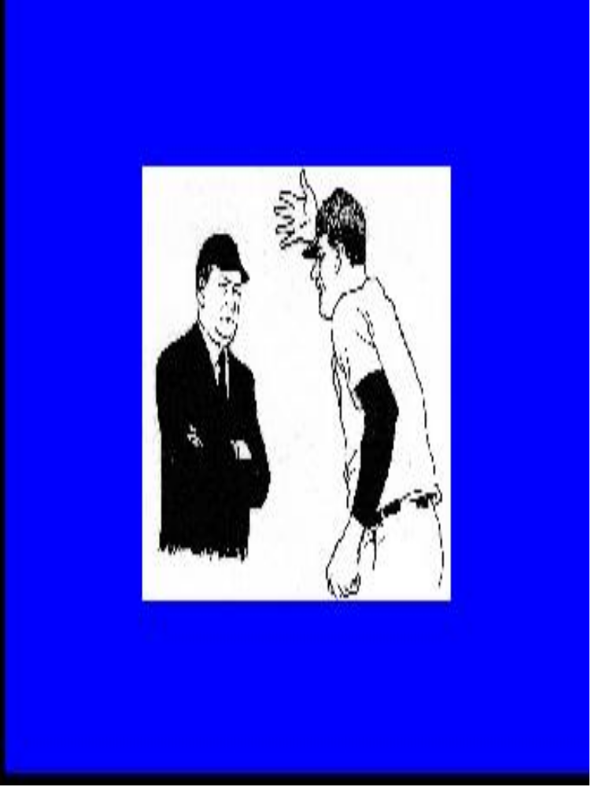
Defensive
Generally among colleagues or peers
or
In elders it is for the right to be heard
Crossed arm Defensive

Slide 55
Physical Characteristics
Not all nonverbal communication comes through movement and motion
Some are static self presentation characteristics
  body height
  weight
  hair
  skin color
  breath odor

Slide 56
Artifacts
When objects interact with persons to send nv cues
- clothes - lipstick
- false eyelashes
  - wigs
  - perfume

Slide 57
Environmental Factors
Associated with the communication event that impinge upon the human relationship, but not part of it.
  furniture
  architectural style
  interior decorating
  lighting conditions
  colors
  temperature

Slide 58
First Impression
We know the importance of “first impression”
But first impressions happen everytime when we initiate the communication.
Positive first impression make communications much easier and more comfortable.
Negative first impressions can cut off a relationship before it gets started.

Slide 59
First Impression
First impression includes:
Dress & grooming
Voice
Handshake
Eye contact
Body posture

Slide 60
Language of Gestures
Body language and nonverbal communication are transmitted through the eyes, face, hands, arms, legs and posture (sitting and walking)
Each individual, isolated gesture is like a word in sentence; it is difficult and isolated dangerous to interpret in and of itself.
Therefore consider the gesture in the light of everyhing else that is going on around you.

Slide 61
Eyes
Windows of the soul, excellent indicators of feelings.
Honest person has a tendency to look you straight in the eye when speaking.
At least listeners accept it like that. People avoid eye contact with other person when an uncomfortable question asked.
Try to reduce tension and build trust rather than increase tension.
The raising of one eyebrow shows disbelief and two shows surprise.
People are classified as right lookers and leftlookers. Right lookers are more influenced by logic and precision, left lookers are found to be more emotional, subjective and suggestible.

Slide 62
The Face
The face is one of the most reliable indicators of a person’s attitudes, emotions & feelings
By analysing facial expressions, interpersonal attitudes can be discerned and feedback obtained.
Some people try to hide their true emotions.
Common facial gestures are:
Frowns: unhappiness, anger
Smiles: happiness
Sneers: dislike, disgust
Clenched jaws: tension, anger
Pouting lips: sadness.

Slide 63
The Hands
Tightly clenched hands usually indicate that the person is experiencing undue pressure.
It may be difficult to relate to this person because of his tension and disagreement.
Superiority and authority are usually indicated when you are standing and joining your hands behind your back.
Cupping one or both hands over the mouth, especially when talking, may well indicate that the person is trying to hide something
Putting your hand to your cheek or stroking your chin generally portrays thinking, interest or consideration.
Fingers bent across the chin or below the mouth most often shows critical evaluation.
Rubing gently behind or beside the ear with the index finger or rubbing the eye usually means the other person is uncertain about what you are saying.
Leaning back with both hands supporting the head usually indicates a feeling of confidence or superiority.

Slide 64
The Arms and Legs
Crossed arms tend to signal defensiveness. They seemingly act as a protective guard against an anticipated attack or a fixed position which the other person would rather not move.
Conversely, arms open and extended toward you generally indicate openness and acceptance.
Crossed legs tend to seem disagreement.People who tightly cross their legs seem to be saying that they disagree with what you are saying or doing. If the people have tightly crossed legs and tightly crossed arms, their inner attitude is usually one of extreme negativity toward what is going on around them. It may be difficult to get agreement.

Slide 65
Posture: Sitting and Walking
Sitting with your legs crossed and elevated foot moving in a slight circular motion indicates boredom or impatience.
Interest and involvement are usually projected by sitting on the edge of the chair and leaning slightly forward.
Generally, people who walk fast and swing their arms freely tend to know what they want and to go after that. People who walk with their shoulders hunched and hands in their pockets tend to be secretive and critical. They don’t seem to like much of what is going on around them.
Dejected people usually scuffle along with their hands in pockets, heads down, and shoulders hunched over.
People who are preoccupied or thinking, usually walk with their heads down, hands clasped behind their backs and pace very slowly.

Slide 66
Interpreting Gesture Clusters
Certain combinations of gestures are especially reliable indicators of a person’s true feelings. These combinations are clusters.
Each gesture is dependent to others, so analysis of a person’s body language is based on a series of signals to ensure that the body language clearly and accurately understood.
All the individual gestures fit together to project a common, unified message.
When they do not, this means a incongruity.
For example: A nervous lough.
A laugh generally signal of relaxation. But if there are nervous signals in body language that means the person is trying to escape from an unpleasent situation.

Slide 67
Common Gesture Clusters
Openness:
Several gestures indicate openness and sincerety
Open hands,
unbuttoned coal or collar,
leaning slightly forward in the chair,
removing coat or jacket,
uncrossing arms and legs, moving closer.
When people are proud of what they have done, they usually show their hands quite openly.
When they are not often put their hands into their pockets, or hide back
When people show signals of openness that means they are generally beginning very comfortable in your presence which is good.

Slide 68
Common Gesture Clusters
Defensiveness:
People who are defensive usually have
a rigid body,
arms or legs tightly crossed,
eyes glancing sideways or darting occasionaly.
minimal eye contact
lips pursed, fists clenched and downcast head
Common Gesture Clusters
Nervousness
Whistling,Jingling pocket change , Fidgeting, Twitching lips or face Clearing one’s throat,Chain smoking. Covering the mouth with hand,
Tapping fingers

Slide 69
Common Gesture Clusters
Evaluation:
Evaluation gestures say that the other person is being thoughtful or is considering what you are saying. Sometimes in a friendly way sometimes in an unfriendly way.
Typical evaluation gestures include
tilted head,hand to cheek, leaning forward and chin stroking
Sometimes evaluation gestures take on a critical aspect.
The body is more drawn back
The hand is to the face but the chin is in the palm of the hand with one finger going up the cheek and the other fingers positioned below the mouth.
This is generally an unfavorable gesture.
To gain time for evaluating the situation people use cigarette or pipe smoking habits, removing eyeglasses.
A final negative evaluation gesture is dropping his eyeglasses to the lower bridge of noise and peering over them.
This gesture usually causes a negative emotional overreaction in other people.

Slide 70
Suspicion, Secrecy, Rejection, and Doubt:
These negative emotions are communicated typically by:
Sideways glances
Minimal or no eye contact
Shifting the body away from the speaker
Touching or rubbing the nose.
When a person do not want to look at you it could mean he is being secretive, has private feelings in opposition to what you are saying or hiding something.
A sideway glances means suspicion and doubt.
Shifting your body from someone means you wish to end the conversation, meeting etc.
Touching nose may indicate doubt or concealment

Slide 71
Common Gesture Clusters Readiness
Readiness is related to the goal-oriented high achiever with a concern for getting things done.
It communicates dedication to a goal and is usually communicated by sitting forward at the edge of a chair.
This may negatively give the appearence of being overly anxious also.

Slide 72
Common Gesture ClustersBoredom or Impatience
These unproductive feelings are usually conveyed by the
Drumming of fingers
Cupping the head in the palm of the hand,
Foot swinging
Brushing or picking a lint
Looking at your watch or the exit
Common Gesture ClustersEnthusiasm.
This is an emotion hat you love to see in other people and they in you. It is conveyed by
A small upper or inward smile,Hands open and arms extended outward,Eyes wide an alert, A lively and bouncy walk,A lively and well-modulated voice.

Slide 73
Words & Phrases That Usually Annoy and Hurt People
You should have known better…..
I can see no point in ..
You must realize that..
I find it difficult to believe….
Don’t be stupid..
You can’t do that…
That’s irrelevant...
Avoid absolutes unless you mean them.
Avoid putting the other person down.
Avoid superior sounding judgements.

Slide 74

Saying What We Really Mean
The price we pay for not saying what we mean - or saying something we didn’t mean can cause guilt, anger, loss of self esteem.
Accusation, screaming, and aggressiveness can’t prove our point.

Slide 75
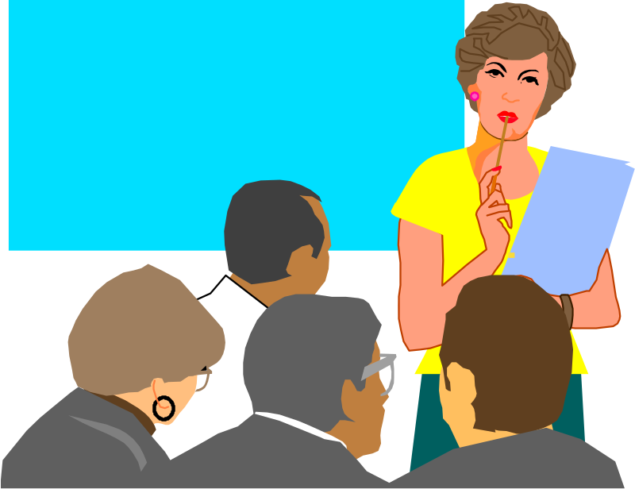
Informing Without Hurting
First try listening to others.
Acknowledge Others’ views and feelings.
Inform without hurting.
Avoid the word ‘never’ and the use of ‘You - messages’ e.g.
“ You are always late. You have never……”

Slide 76
THANKS !

